Slide 1
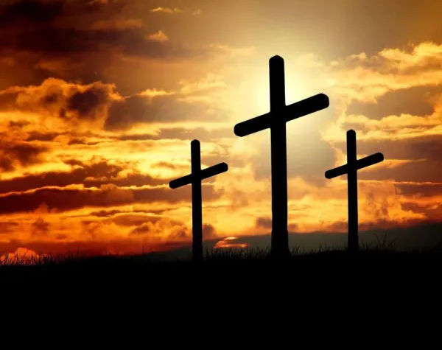
Hosanna (Praise Is Rising)

Slide 2
G C
Praise is rising, eyes are turning to You
G
We turn to You
G C
Hope is stirring, hearts are yearning for You
G
We long for You

Slide 3
D
'Cause when we see You
C G
We find strength to face the day
D
And in Your presence
C G
All our fears are washed away
D
washed away

Slide 4
G Em C
Hosanna, hosanna
G D
You are the God who saves us,
Em C
worthy of all our praises
X2 to verse 2

Slide 5
G C
Hear the sound of hearts returning to You
G
We turn to You
G C
In Your kingdom broken lives are made new
G
You make us new

Slide 6
D
'Cause when we see You
C G
We find strength to face the day
D
And in Your presence
C G
All our fears are washed away
D
washed away

Slide 7
G Em C
Hosanna, hosanna
G D
You are the God who saves us,
Em C
worthy of all our praises

Slide 8
G Em C
Hosanna, hosanna
G D
Come have Your way among us
Em C
We welcome You here Lord Jesus

Slide 9
D
'Cause when we see You
C G
We find strength to face the day
D
And in Your presence
C G
All our fears are washed away
D
washed away
x2 to chorus

Slide 10
G Em C
Hosanna, hosanna
G D
You are the God who saves us,
Em C
worthy of all our praises

Slide 11
G Em C
Hosanna, hosanna
G D
Come have Your way among us
Em C
We welcome You here Lord Jesus
play x2 END

Slide 12
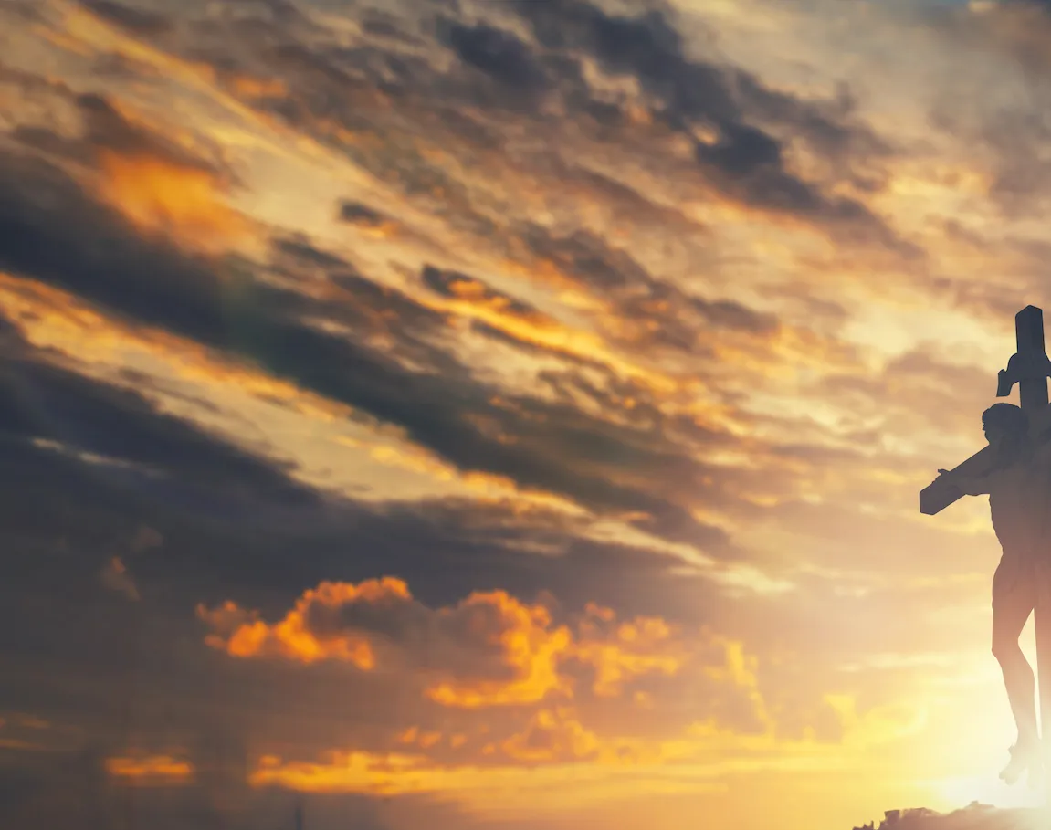
Yet Not I but Through Christ In Me

Slide 13
C F C F
C C F
What gift of grace is Jesus my redeemer
C Am G
There is no more for heaven now to give
C F
He is my joy, my righteousness, and freedom
C G C
My steadfast love, my deep and boundless peace

Slide 14
F C
To this I hold, my hope is only Jesus
F C Gsus G
For my life is wholly bound to His
C Dm C F
Oh how strange and divine, I can sing all is mine,
C G C F C F
Yet not I but through Christ in me

Slide 15
C F
The night is dark, but I am not forsaken
C Am G
For by my side, the Savior, He will stay
C F
I labor on in weakness and rejoicing
C G Csus C
For in my need, His power is displayed

Slide 16
F C
To this I hold, my Shepherd will defend me
F C Gsus G
Through the deepest valley He will lead
C Dm C F
Oh the night has been won, and I shall overcome
C G C F C F
Yet not I but through Christ in me

Slide 17
C F
No fate I dread, I know I am forgiven
C Am G
The future sure, the price it has been paid
C F
For Jesus bled and suffered for my pardon
C G Csus C
And He was raised to overthrow the grave

Slide 18
F C
To this I hold, my sin has been defeated
F C Gsus G
Jesus now and ever is my plea
C Dm C F
Oh the chains are released, I can sing I am free
C G C F C F
Yet not I but through Christ in me

Slide 19
C F
With every breath I long to follow Jesus
C Am G
For He has said that He will bring me home
C F
And day by day I know He will renew me
C G Csus C
Until I stand with joy before the throne

Slide 20
F C
To this I hold, my hope is only Jesus
F C Gsus G
All the glory evermore to Him
C Dm C F
When the race is complete, still my lips shall repeat
C G C
Yet not I but through Christ in me
REPEAT

Slide 21
C Dm C F
When the race is complete, still my lips shall repeat
C G Am F
Yet not I but through Christ in me
C G Am F
Yet not I but through Christ in me
C G C F C F
Yet not I but through Christ in me
END

Slide 22
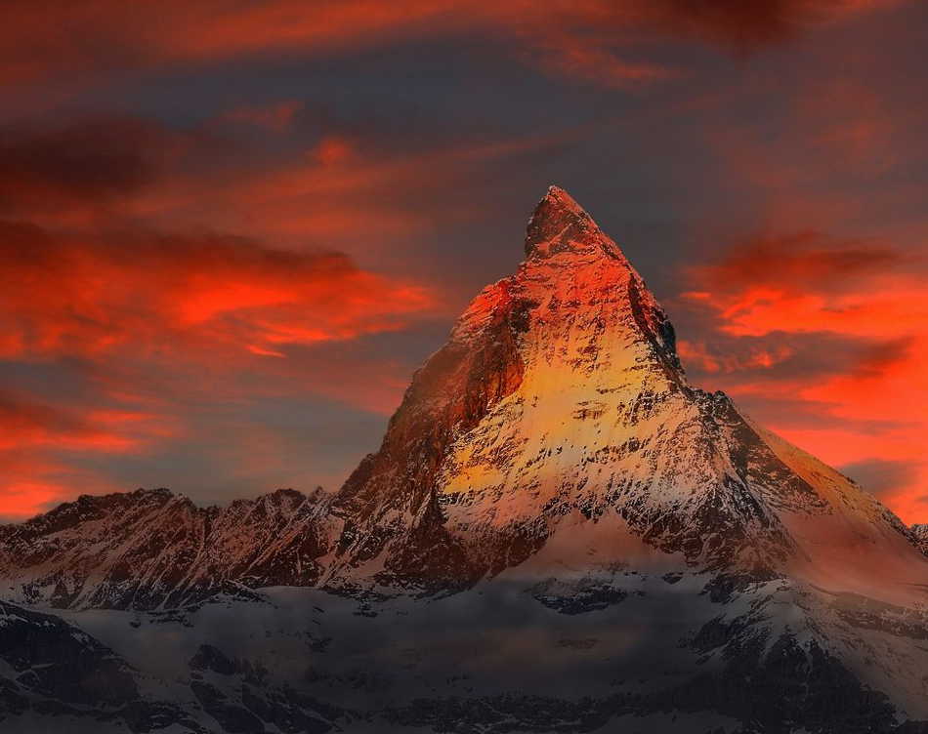
Hymn of Heaven

Slide 23
C Csus C
How I long to breathe the air of Heaven
Am F G
Where pain is gone and mercy fills the streets
C F C G Am
To look upon the one who bled to save me
F G C Csus C
And walk with Him for all eternity
To CHORUS

Slide 24
C F G C
Oh, There will be a day When all will bow before Him
C F Am G
There will be a day When death will be no more
C F G C G Am
Standing face to face With He who died and rose again
F G C
Holy holy is the Lord
TO VERSE

Slide 25
C F C
Every prayer we prayed in desperation
Am F G
The songs of faith we sang through doubt and fear
C F C G Am
In the end we’ll see that it was worth it
F G C Csus C
When He returns to wipe away our tears
TO CHORUS

Slide 26
C F G C
Oh, There will be a day When all will bow before Him
C F Am G
There will be a day When death will be no more
C F G C G Am
Standing face to face With He who died and rose again
F G C
Holy holy is the Lord
TO VERSE

Slide 27
C F C
On that day we join the resurrection
Am F G
And stand beside the heroes of the faith
C F C G Am
With one voice a thousand generations
F G C
Sing “worthy is the Lamb who was slain”
TO VERSE

Slide 28
C F C
On that day we join the resurrection
Am F G
And stand beside the heroes of the faith
C F C G Am
With one voice a thousand generations
F G C
Sing “worthy is the Lamb who was slain”
F G C Csus C
“Forever He shall reign”
TO CHORUS

Slide 29
C F G C
So let it be today we shout the hymn of Heaven
C F Am G
With angels and the Saints we raise a mighty roar
C F G C G Am
“Glory to our God” who gave us life beyond the grave
F G C
Holy holy is the Lord
TO CHORUS

Slide 30
C F G C
So let it be today we shout the hymn of Heaven
C F Am G
With angels and the Saints we raise a mighty roar
C F G C G Am
“Glory to our God” who gave us life beyond the grave
F G Am
Holy holy is the Lord
F G Am
Holy holy is the Lord
F G C Csus C
Holy holy is the Lord
END

Slide 31
In Jesus Name (God of Possible)

Slide 32
Bm G
I speak the name of Jesus over you
D A
In your hurting, in your sorrow, I will ask my God to move
Bm G
I speak the name 'cause it's all that I can do
D A
In desperation I'll seek heaven and pray this for you
CAPO @ 3rd (F)

Slide 33
Bm G
I pray for your healing, that circumstances would change
D A
I pray that the fear inside would flee in Jesus name
Bm D
I pray that a breakthrough would happen today
D A
I pray miracles over your life in Jesus name
Bm D G
In Jesus name
To verse 2

Slide 34
Bm G
I speak the name of all authority
D A
Declaring blessings, ev'ry promise He is faithful to keep
Bm G
I speak the name no grave could ever hold
D A
He is greater, He is stronger, He's the God of possible
To Chorus

Slide 35
Bm G
I pray for your healing, that circumstances would change
D A
I pray that the fear inside would flee in Jesus name
Bm D
I pray that a breakthrough would happen today
D A
I pray miracles over your life in Jesus name
Bm G
In Jesus name
To Bridge

Slide 36
Em G
Come believe it, come receive it
D Asus A
Oh, the power of His Spirit is now forever yours
Em G
Come believe it, come receive it
D Asus A
In the mighty name of Jesus, all things are possible
To Chorus

Slide 37
Bm G
I pray for your healing, that circumstances would change
D A
I pray that the fear inside would flee in Jesus name
Bm D
I pray that a breakthrough would happen today
D A
I pray miracles over your life in Jesus name

Slide 38
Bm G
I pray for revival, for restoration of faith
D
I pray that the dead will come alive
Asus A Bm
In Jesus name, in Jesus name
Bm / G / D / A
END

Slide 39
I Surrender All

Slide 40
G D
All to Jesus I surrender
Em C D G
All to Him I freely give
G D
I will ever love and trust him
Em C D G
In His presence daily live

Slide 41
G Am D G
I surrender all, I surrender all
G Em C
All to thee, my blessed Savior
G D G
I surrender all

Slide 42
G D
All to Jesus I surrender
Em C D G
Humbly at His feet I bow
G D
Worldly pleasures all forsaken
Em C D G
Take me, Jesus, take me now

Slide 43
G Am D G
I surrender all, I surrender all
G Em C
All to thee, my blessed Savior
G D G
I surrender all

Slide 44
G D
All to Jesus I surrender
Em C D G
Make me, Savior, wholly Thine
G D
Let me feel Thy Holy Spirit
Em C D G
Truly know that Thou art mine

Slide 45
G Am D G
I surrender all, I surrender all
G Em C
All to thee, my blessed Savior
G D G
I surrender all

Slide 46
G D
All to Jesus I surrender
Em C D G
Lord, I give myself to Thee
G D
Fill me with Thy love and power
Em C D G
Let Thy blessing fall on me

Slide 47
G Am D G
I surrender all, I surrender all
G Em C
All to thee, my blessed Savior
G D G
I surrender all

Slide 48
G D
All to Jesus I surrender
Em C D G
Now I feel the sacred flame
G D
Oh, the joy of full salvation
Em C D G
Glory, glory to His name

Slide 49
G Am D G
I surrender all, I surrender all
G Em C
All to thee, my blessed Savior
G D G
I surrender all
END

